Slide 1
De/Multiplexer

Slide 2
Multiplexer / Demultiplexer
The basic function of the Multiplexer (MUX).
The typical application of a MUX.
A 4-to-1 MUX designed with SSI.
A 4-to-1, 8-to-1, & 16-to-1 MUX.
The basic function of the Demultiplexer (DEMUX).
The typical application of a DEMUX.
A 1-to-4 DEMUX design with SSI.
A 1-to-4, 1-to-8, & 1-to-16 MSI DEMUX.
A 7-segment message display using MUX/DEMUX.
SSI - Small Scale Integration MSI - Medium Scale Integration
Notes:
Introductory Slide / Overview of Presentation

Slide 3
Multiplexer (MUX) = Selector
is a digital switch that has multiple inputs (sources) and a single output (destination).
Multiplexer
Block Diagram
The select lines determine which input is connected to the output.
MUX Types
→ 2-to-1 (1 select line)
→ 4-to-1 (2 select lines)
→ 8-to-1 (3 select lines)
→ 16-to-1 (4 select lines)
2^{N}
1
Inputs
(sources)
MUX
Output
(destination)
N
Select
Lines

Slide 4


Typical Application of a MUX
Multiple Sources
Single Destination
Selector
MP3 Player
Docking Station
D0
D1
D2
D3
Laptop
Sound Card
MUX
Y
Surround Sound System
Digital
Satellite
B | A | Selected Source
0 | 0 | MP3
0 | 1 | Laptop
1 | 0 | Satellite
1 | 1 | Cable TV
Digital
Cable TV
Notes:
This slide shows a typical application of a multiplexer (in this case a 4-to-1 MUX). Have the students share other common applications of MUXs.
http://images.tigerdirect.ca/skuimages/large/Logitech-X-540-L23-7250-mai.jpg

Slide 5
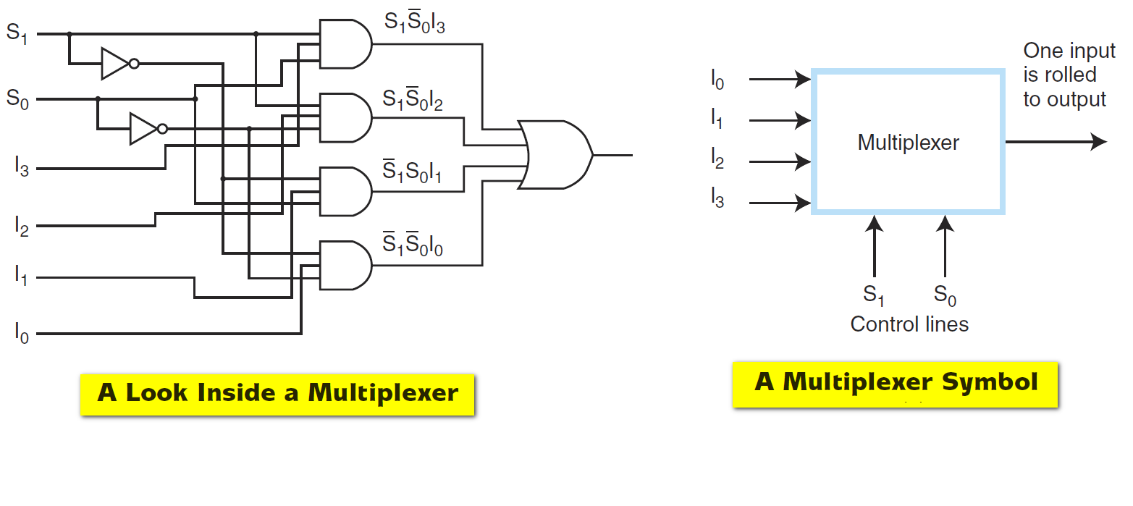
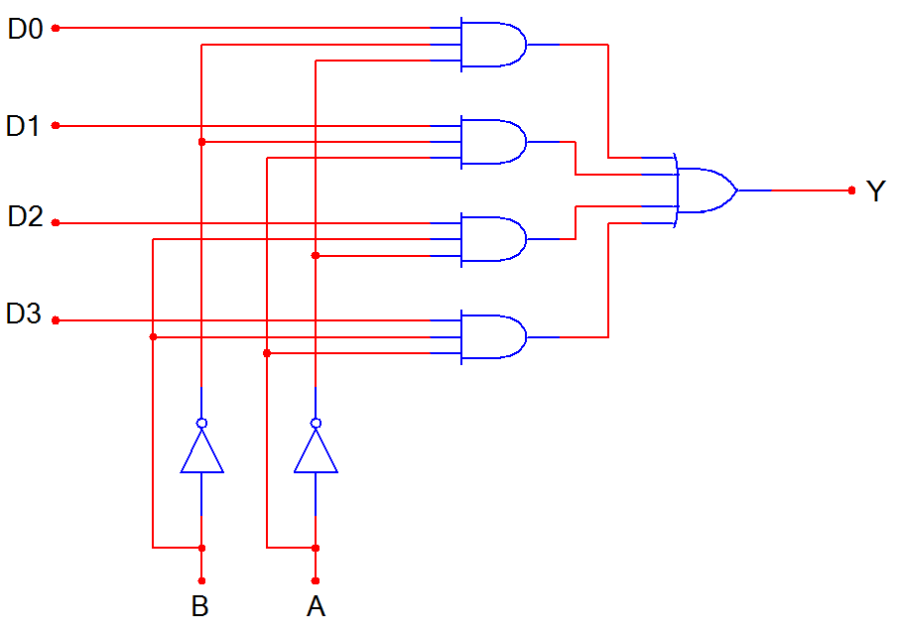
4-to-1 Multiplexer (MUX)
D0
D1
D2
D3
MUX
Y
B A
B | A | Y
0 | 0 | D0
0 | 1 | D1
1 | 0 | D2
1 | 1 | D3
Notes:
SSI logic diagram, block diagram, and truth table for a 4-to-1 MUX

Slide 6
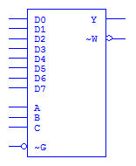
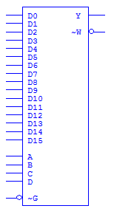
Medium Scale Integration MUX
4-to-1 MUX
8-to-1 MUX
16-to-1 MUX
Inputs
Output (Y)
(and inverted output)
Select
Enable
Notes:
Block diagrams for 4-to-1, 8-to-1, and 16-to-1 MSI Multiplexers.

Slide 7
What is a Demultiplexer (DEMUX)?
A DEMUX is a digital switch with a single input (source) and a multiple outputs (destinations).
The select lines determine which output the input is connected to.
DEMUX Types
→ 1-to-2 (1 select line)
→ 1-to-4 (2 select lines)
→ 1-to-8 (3 select lines)
→ 1-to-16 (4 select lines)
Demultiplexer
Block Diagram
1
2^{N}
Input
(source)
DEMUX
Outputs
(destinations)
N
Select
Lines
Notes:
This slide explains the function of a demultiplexer.

Slide 8
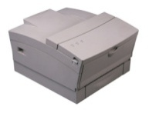
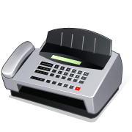
Typical Application of a DEMUX
Multiple Destinations
Single Source
Selector
B/W Laser
Printer
Fax
Machine
D0
D1
D2
D3
X
DEMUX
Color Inkjet
Printer
B | A | Selected Destination
0 | 0 | B/W Laser Printer
0 | 1 | Fax Machine
1 | 0 | Color Inkjet Printer
1 | 1 | Pen Plotter
Pen
Plotter
Notes:
This slide shows a typical application of a demultiplexer (in this case a 1-to-4 DEMUX). Ask students to share other common applications of DEMUXs.

Slide 9
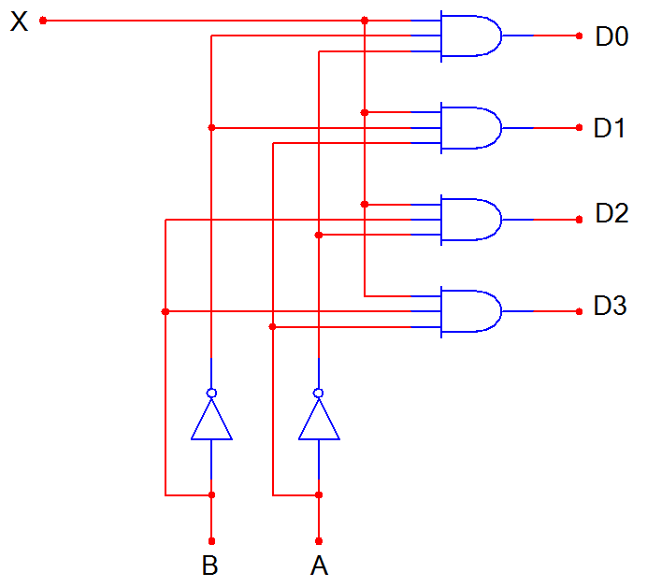
1-to-4 De-Multiplexer (DEMUX)
D0
D1
D2
D3
X
DEMUX
B A
B | A | D0 | D1 | D2 | D3
0 | 0 | X | 0 | 0 | 0
0 | 1 | 0 | X | 0 | 0
1 | 0 | 0 | 0 | X | 0
1 | 1 | 0 | 0 | 0 | X
Notes:
SSI logic diagram, block diagram, and truth table for a 1-to-4 De-MUX

Slide 10
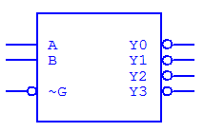
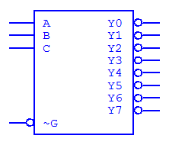
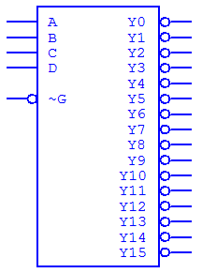
Medium Scale Integration DEMUX
1-to-4 DEMUX
1-to-8 DEMUX
16-to-1 MUX
Select
Outputs
(inverted)
Input
(inverted)
Note : Most Medium Scale Integrated (MSI) DEMUXs , like the three shown, have outputs that are inverted. This is done because it requires few logic gates to implement DEMUXs with inverted outputs rather than no-inverted outputs.
Notes:
Block diagrams for 1-to-4, 1-to-8, and 1-to-16 MSI Demultiplexers.

Slide 11


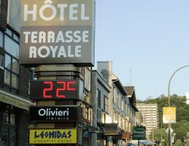

Seeing Is NOT Always Believing
Our lives are filled with ele-ctronic signs that display the time, temperature, or ball game score. However, what we see is not always what is really happening.
In fact for most displays, the individual display segments are cycled through so that only one display is on at any given time.
The cycle speed is so fast that the human eye perceives that all segments are on.
brgprecision.com
electronic-scoreboard.com
digicam-tech.com
nu-mediadisplays.com/signs/time-displays.php
Notes:
This slide provides examples of various electronics signs and explains that display segments are not all on simultaneously.
www.brgprecision.com
www.digicam-tech.com
www.electronic-scoreboard.com
http://www.nu-mediadisplays.com/signs/time-displays.php

Slide 12
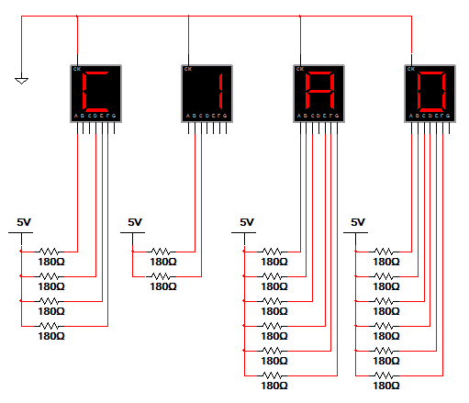
Simple Message: All Segments On
The circuit to the right uses four 7-segment displays to display the word CIAO. In this circuit all displays are continuously illuminated, each displaying one letter in the word.
Though this method works, it is a VERY inefficient use of power. To illuminate the simple message CIAO in this way, 18 segments must be continuously on.
Can you think of another way to display this message that would use less power?
Notes:
This slide shows how a simple message can be displayed using seven-segments displays. The drawback to this method is that all displays are on simultaneously. To display CIAO, 18 segments must be on, all drawing current and using power. Ask students to consider ways that they could display the message WITHOUT running all displays simultaneously.

Slide 13
Demonstrations
How Logic Gates Work?
EDUCYPEDIA – electronics:
2-Bit Binary Decoder
8-Bit Ripple Counter

